Slide 1
Healthcare Dashboard Data Summary Report
kaushikmaji44@gmail.com / Kaushik Maji

Slide 2
About the dataset
Relevant inquiries

Slide 3
About the dataset

Slide 4
About the dataset
The Healthcare Dashboard dataset includes diverse patient data across multiple tables. Key insights: average patient age is 39.86, satisfaction score is 4.30, and total patient count is 9201. The 21-30 age group has the highest count of 1206, and peak wait time is 37.22 minutes at 03:00 AM.

Slide 5
Relevant inquiries

Slide 6
Trends in Patient Wait Times
Yearly and Monthly Distribution: Data spans 2022 to 2023, with an average month of 6.68.
Average Wait Time: Approximately 35.25 minutes; fluctuations noted.
Trends: Slight upward trend in wait times; variability suggests influence from seasonal demand and staffing levels.

Slide 7
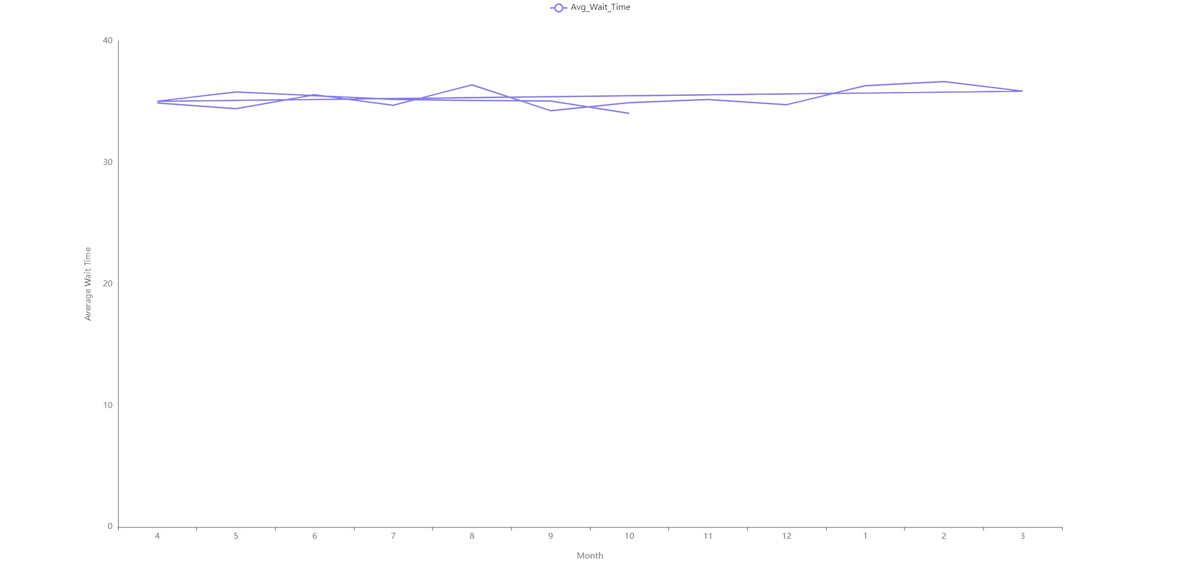

Slide 8
Patient Satisfaction by Department
Highest Satisfaction: Gastroenterology leads with a score of 5.81.
Lowest Satisfaction: Renal scores 5.09, highlighting improvement needs.
Overall Consistency: Scores range from 5.09 to 5.81, indicating generally consistent patient satisfaction across departments.

Slide 9
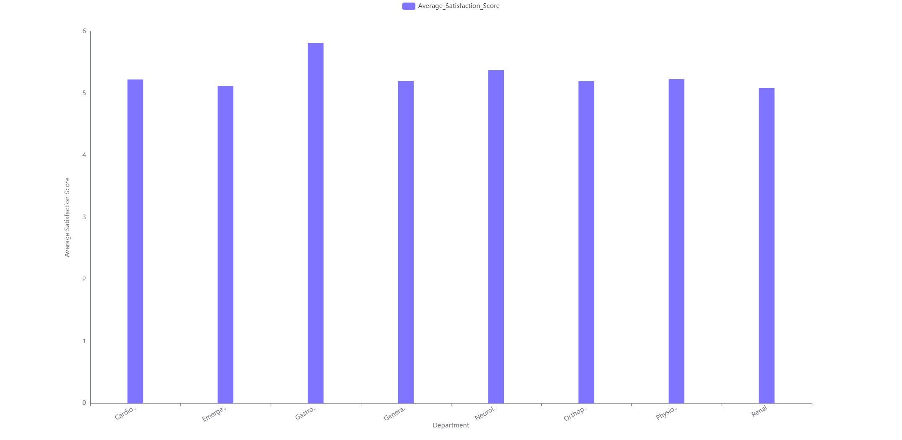

Slide 10
Patient Wait Time and Satisfaction
Weak Negative Correlation: The correlation coefficients are -0.026 (raw) and -0.019 (hospital), indicating a very weak negative relationship between patient wait time and satisfaction score.
Management Implications: Hospitals should consider strategies to reduce wait times to potentially enhance patient satisfaction, despite the minimal impact.

Slide 11
Patient Wait Times Distribution
Time Range: Dataset covers 24 hours from '00:00:00' to '23:00:00'.
Average Wait Time: Ranges from 33.88 to 37.22 minutes, mean of 35.24 minutes.
Peak Times: Highest wait at 03:00 and 22:00, indicating high demand or staffing issues.

Slide 12
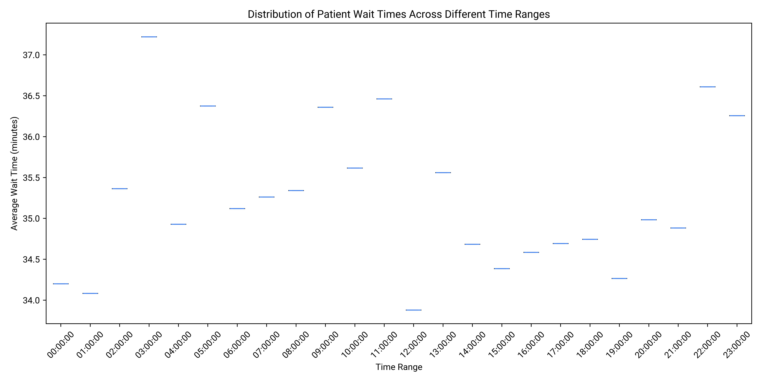

Slide 13
Patient Variations by Time
Patient Counts: Highest on Fridays and Thursdays (1349), lowest on Mondays (1259).
Time Trends: Peak at 23:00 (435 patients), lowest at 10:00 (349 patients).
Conclusion: Patient visits are more frequent late at night and less frequent mid-morning.

Slide 14
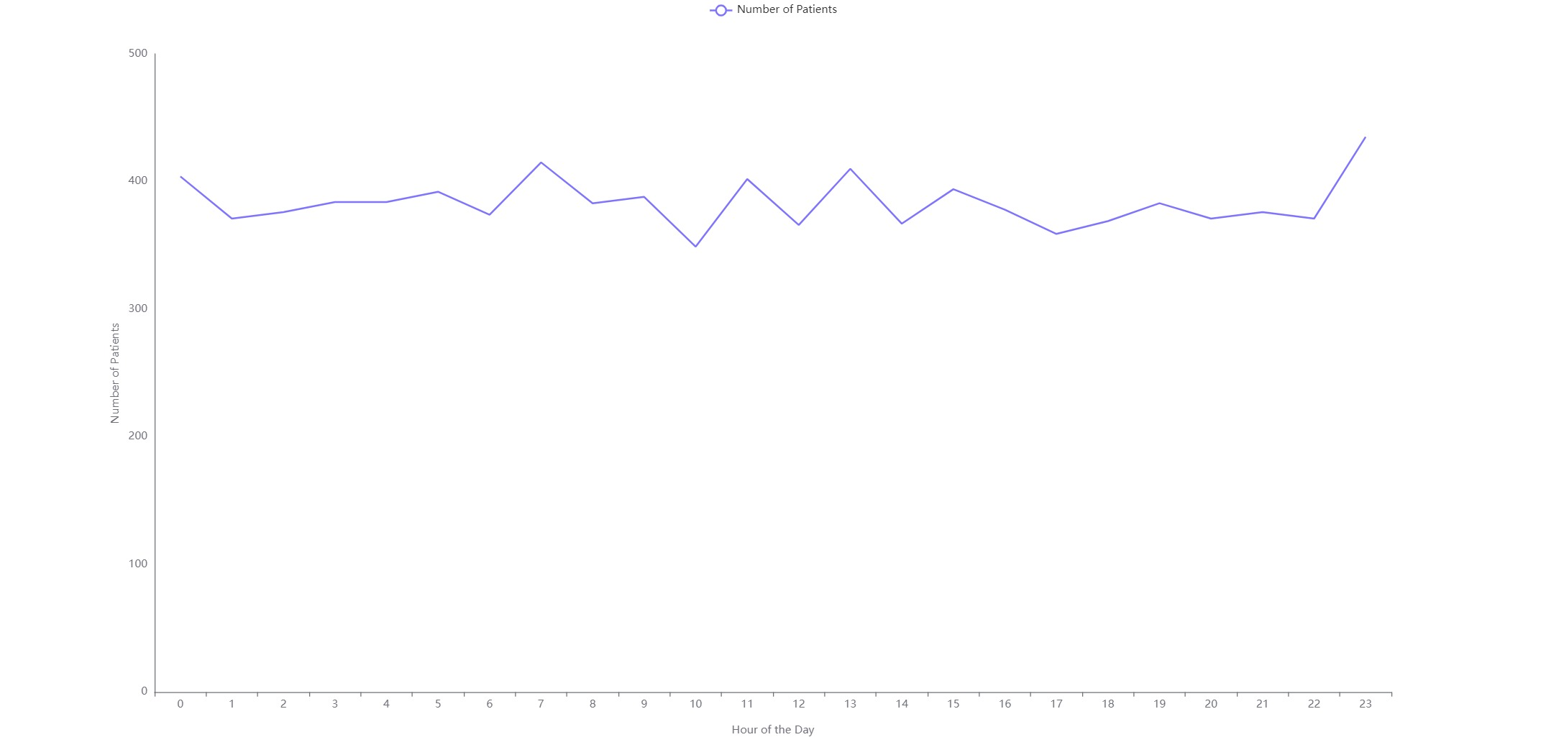

Slide 15
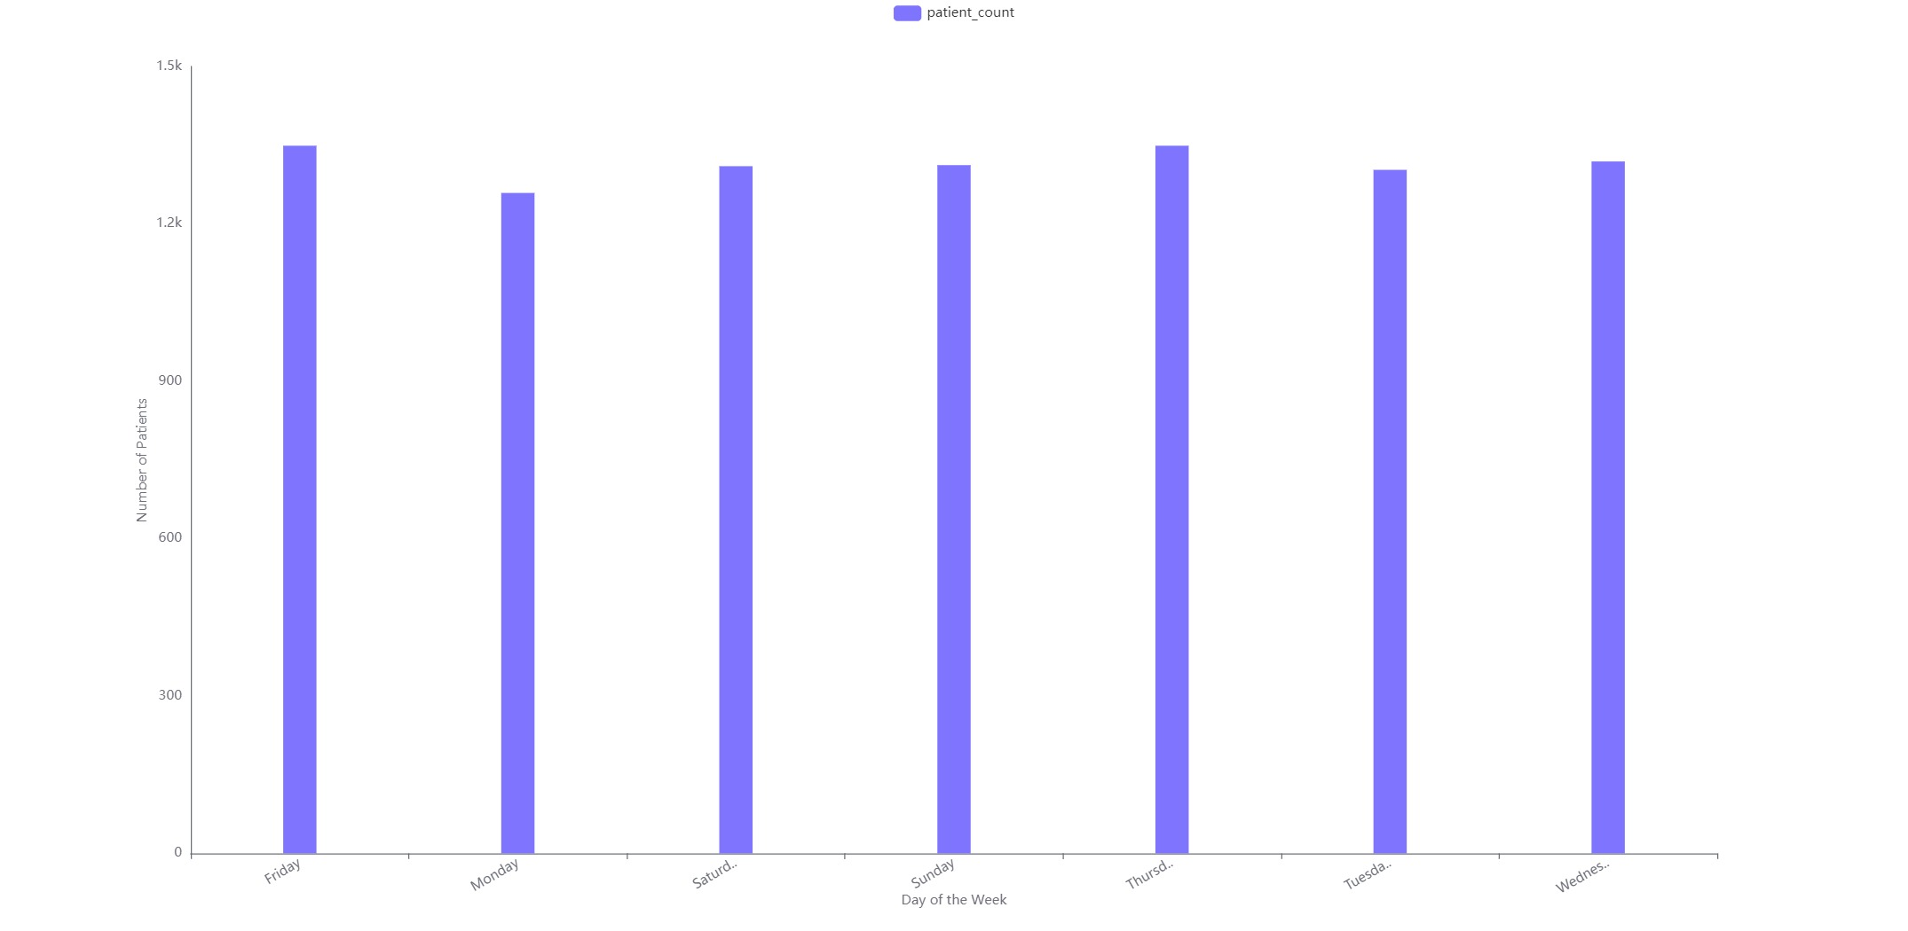

Slide 16
Patient Wait Times and Satisfaction
Mean Correlation: Average correlation is -0.37; specific value is -0.365.
Negative Correlation: Longer wait times lead to lower satisfaction scores.
Universal Impact: This trend is consistent across racial groups, indicating that reducing wait times could enhance patient satisfaction for all.

Slide 17
Patient Wait Time by Department
Highest Wait Time: Neurology at 36.80 minutes.
Lowest Wait Time: Renal at 34.70 minutes.
Overall Variation: Average wait times are close, with a standard deviation of 0.78 minutes across departments.

Slide 18
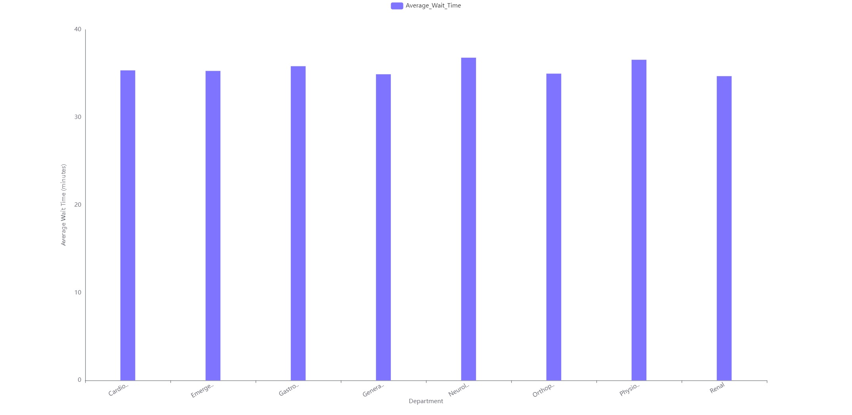

Slide 19
Patient Wait Times and Satisfaction
Correlation Coefficient: Approximately -0.99999 indicates a strong negative correlation between wait times and satisfaction scores.
Insights: Longer wait times lead to lower satisfaction.
Conclusion: Reducing wait times may enhance patient satisfaction, highlighting a key area for healthcare improvement.

Slide 20
Patient Gender Distribution by Department
Emergency Department Dominance: Highest patient count with significant male and female representation.
Balanced Gender Distribution in Cardiology: Equal access to cardiology services among genders.
Data Gaps: Need for additional data on Gastroenterology, General Practice, Neurology, Orthopedics, Physiotherapy, and Renal departments.

Slide 21
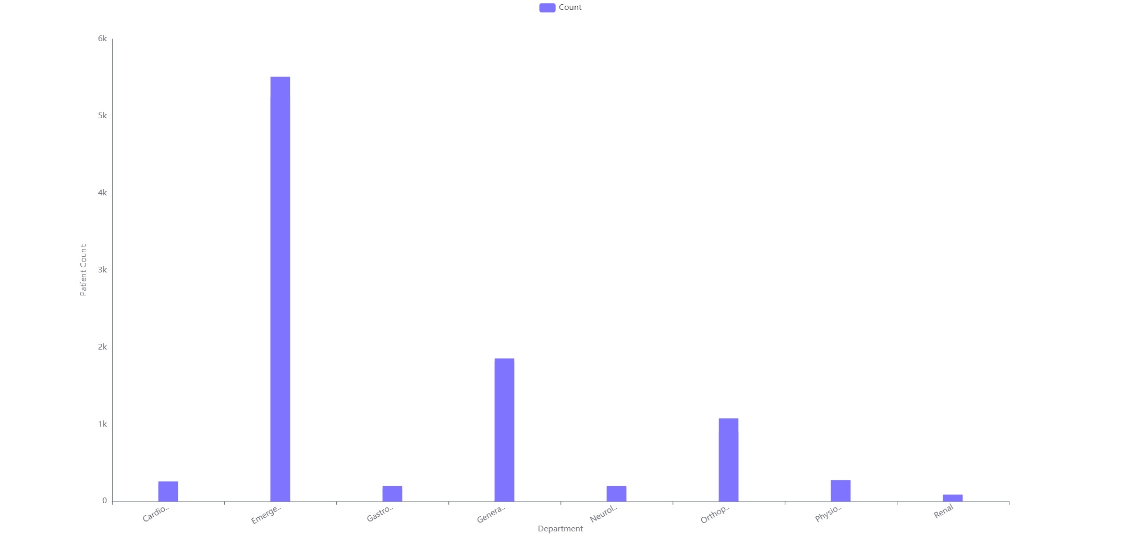

Slide 22
Patient Wait Time Anomalies
Average Wait Time: Overall mean is 35.93 minutes; Neurology has the highest at 38.11 minutes.
Efficiency Insights: Renal department shows better efficiency with a wait time of 34.09 minutes.
Consistency: Most departments exhibit consistent wait times, except for Neurology and Renal.

Slide 23
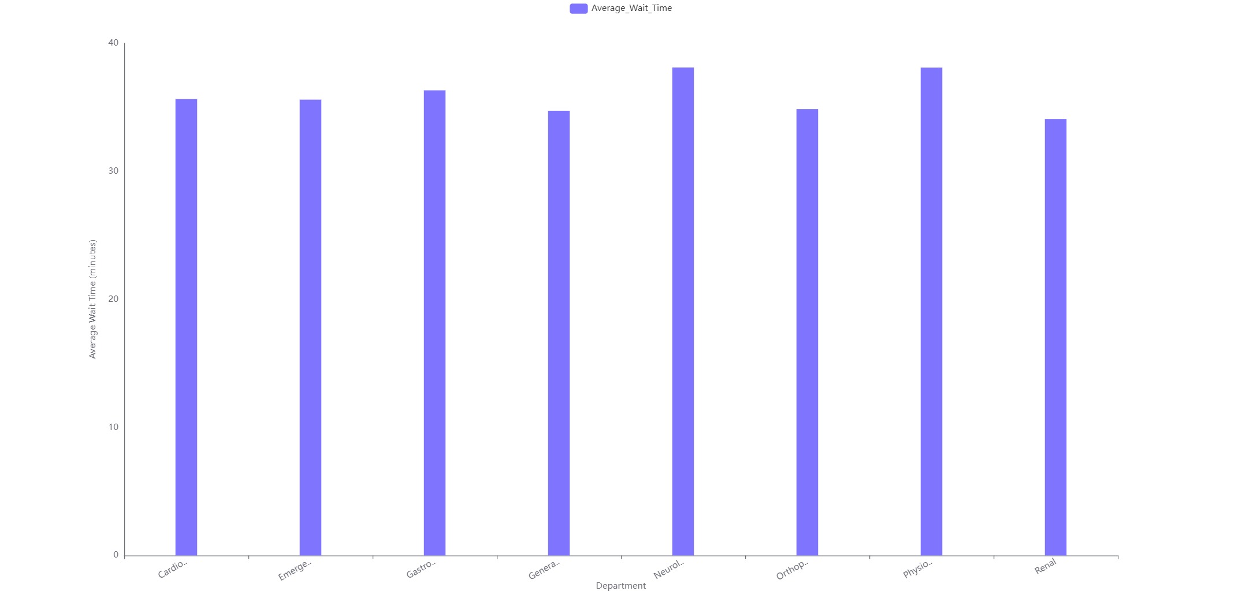

Slide 24
kaushikmaji44@gmail.com / Kaushik Maji

